Slide 1
Welcome Back!
Let’s get to know each other!
The idea of a mingle structure is that, based on what category best fits your personality, you’re able to divide up and share some fun facts about yourself with different people.
Let’s give it a try!

Slide 2
Did you know? Termites eat through wood 2 times faster when listening to rock music.
Divide into the music genre you dig most:
Hardcore
Hip-hop/pop
Country
Rap
Classic Rock
Question: If talent wasn’t an issue, what band would you join, either present or past? Why?

Slide 3
Did you know? The average talker sprays about 300 microscopic saliva droplets per minute, about 2.5 droplets per word.
Divide into the bodily function that disgusts you the most:
Spit
Fart
Burp
Sweat
Question: What is your favorite thing to do?

Slide 4
Did you know? You are more likely to die in a vending machine accident then being struck by lightning.
Divide into the group that best describes your preference in soft drinks:
Coke/Pepsi
Mountain Dew
Dr. Pepper
Gatorade
Water
Question: What is your biggest fear?

Slide 5
Did you know? 90% of pork chops and ground beef contain fecal matter.
Divide into your favorite food category:
Pizza
Mexican
Fast Food
Momma’s Fixin’s
Chinese
Question: If you had a WARNING label, what would it be?

Slide 6
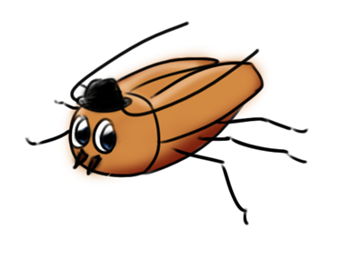
Did you know? A cockroach can live several weeks with its head cut off - it dies from starvation!
Divide into the group that identifies your preferred super power:
Invisibility
Flight
Super Strength
X-ray Vision
Mind Reading
Question: Who is one influential person you’d like to meet and what do you want to learn from him or her?

Slide 7
Did you know? 74% of people read in the bathroom 47% talk on the phone 11% eat in there 40% flush restroom toilets with their feet instead of their hands 51% crumple toilet paper; 49% fold it
Divide into the group that best describes your bathroom habits:
Text
Read
Groom (brush hair, clip nails, etc.)
Meditate
Question: Biggest achievement and/or accomplishment?

